Slide 1
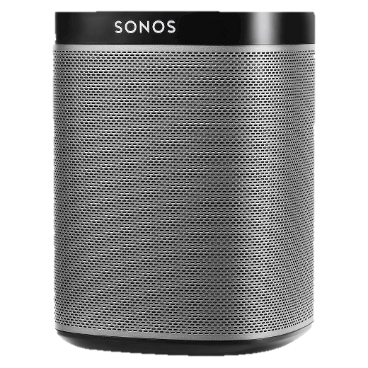
Speaker recognition system diagram
CHALLENGE 2017
Digital signal processing
Feature extraction (MFCC)
Training model
Sample rate converter
Noise reduction
MFC
Coefficient
Vector
SVM
SeqNN
CNN
LSTM
İnput user command
Additionnal delta and delta-delta features
Send username
Send command
Server App
Processing {name,command} and prepare database query
Use case
Establish connection with Speaker and prepare speaker commands
DSP
Training model
Emilien
- Emilien says “play my playlist”
- The server receives {emilien,play my playlist}
- Server queries database for information about Emilien (his playlist)
- Push playlist to Speaker
Play my playlist
Send commands
Query user information
User database
Speaker

